Slide 1
TRAVIS
Travel Chat Bot
Supervisor:-
Mrs. Supriya Shukla
Peeyush Sahu
Khushal Tyagi
Chabil Kansal
Aryan Chauhan
Notes:
1

Slide 2
INTRODUCTION
The Chatbot simulates a real-world travel agent that achieves some result by conversing with the machine in a dialogic fashion using natural language. The need for intelligent agents is growing with the widespread use of personal machines and the desire of their makers to provide natural language interfaces. The proposed system will change how to recommend travel itinerary by incorporating personal preferences, and generating responses using web scraping.
Today, the traditional travel agents present many issues that can be conquered by the digital one. The traditional ones are subject to their availability, the digital agent is available throughout. Moreover, no agent in this world can “know it all”. The data present with an actual travel agent can be limited or outdated, this makes it not so efficient.

Slide 3
TRAVIS is a personalized chatbot capable of interacting with users and perform
certain activities based on the inputs provided by the user.
It is an NLP & Crawler backed chatbot with following functionalities
1) Tell about popular destinations
2) Book Hotels
3) Book Train/Bus/Flight Tickets
4) Places to visit near
5) Information about a place
6) Best eateries nearby
7) Reverse Image search Using third party APIs
3
Notes:
3

Slide 4
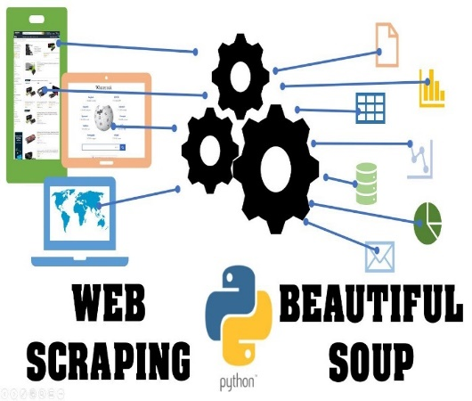

Technologies Used
Web Scraping using Beautiful Soup in Python:
Web scraping is the process of gathering information from
the Internet.
Beautiful Soup is a Python library for parsing structured data. It allows you to interact with HTML in a similar way to how you would interact with a web page using developer tools. Beautiful Soup exposes a couple of intuitive functions you can use to explore the HTML you received.
Flask:
Flask is a popular Python web framework, meaning it is a third-​party Python library used for developing web applications.
4
Notes:
4

Slide 5


Technologies Used
C. Zomato API:
Zomato APIs are application programming interfaces (APIs) developed by Zomato which allow developers communication with Zomato services and their integration to other services. In our project it is used for the searching restaurants.
D. Makemytrip API:
Makemytrip APIs are application programming interfaces (APIs) developed by Makemytrip which allow developers communication with its services and their integration to other services. In our project it is used for the searching hotel.
5
Notes:
5

Slide 6
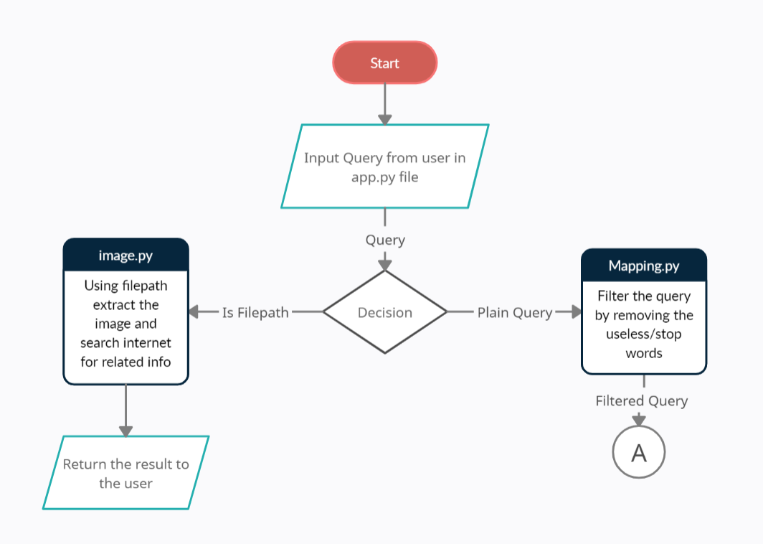
Procedure
6
Notes:
6

Slide 7
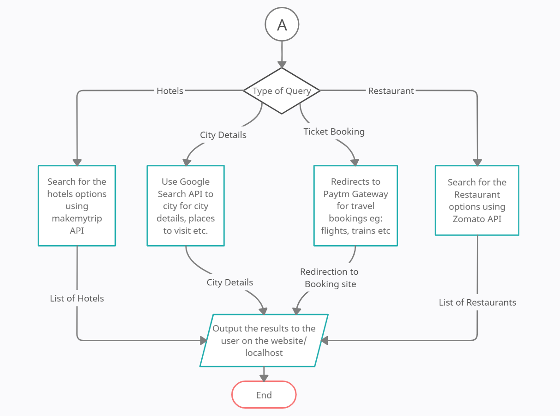
Procedure
7
Notes:
7

Slide 8
CODE AND WORKFLOW

Slide 9
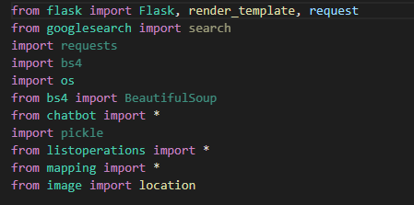
Some Imported Libraries

Slide 10
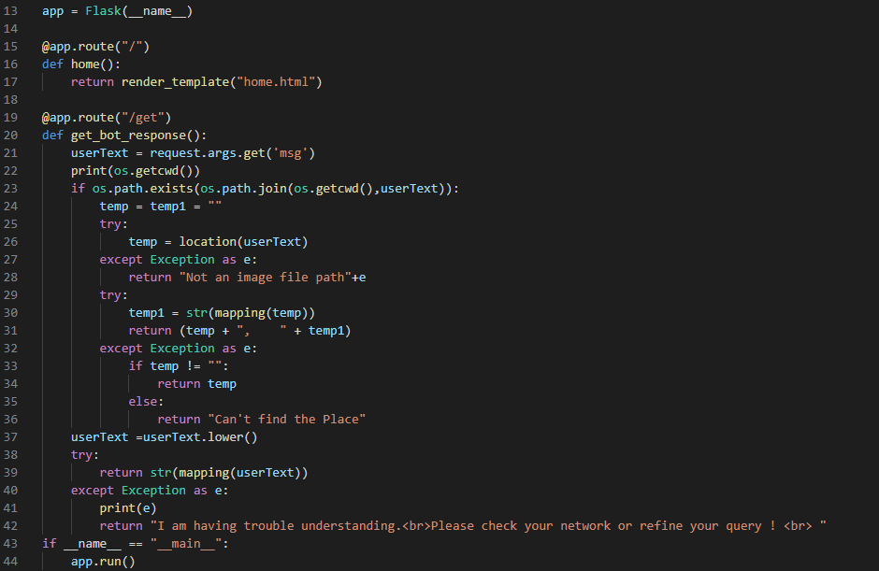
Flask URL Mappings : App.py

Slide 11
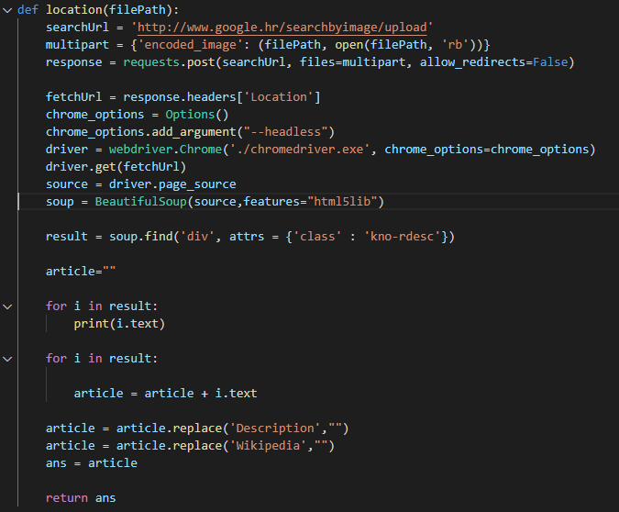
Image.py

Slide 12
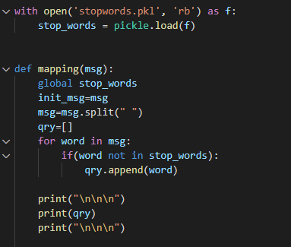
Filtering StopWords

Slide 13
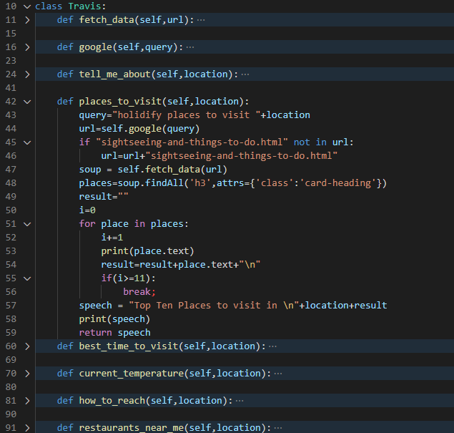
Chatbot Functions

Slide 14
FINAL DEMO
14
Notes:
14

Slide 15
Consider this scenario of two friends planning a trip:
“Semester is about to end. Lets plan our trip !”
”But we are in Lockdown. We cant go anywhere ?”
“We can plan at least. Lockdown is not stopping us”
”Lets Do this !”
“How about Amritsar ?”
”I dont know anything about Amritsar”
“I’ve heard bunch of COER students have made a
Travel Bot. Lets Try It ? “
”Okay !”
15
Notes:
15

Slide 16
Queries :
Tell me about Amritsar.
What is the Best season to visit Amritsar ?
What is the temperature in Amritsar ?
What are the places to visit in Amritsar ?
Golden Temple image path.
What are some places to eat near Amritsar Bus Stand ?
Hotels in Amritsar ?
Nearest Airport to Amritsar ?
Nearest Railway Station to Amritsar ?
I want to book tickets from Hyderabad to Amritsar
16
Notes:
16

Slide 17
Thank You !
17
Notes:
17

